Slide 1


Big Data & HPCC Systems
HPCC-Systems Solution Labs
2020

Slide 2
INTRODUCTION

Slide 3
The HPCC Systems Components
Query
Big Data
Structured
Unstructured
Semi-structured
Thor cluster
Data Refinery
ROXIE cluster
Data Delivery
Visualize
Developer
Using VS Code ECL
ECL
Programming Language
Predictive Modeling
Data Management
High Performance Computing Cluster

Slide 4

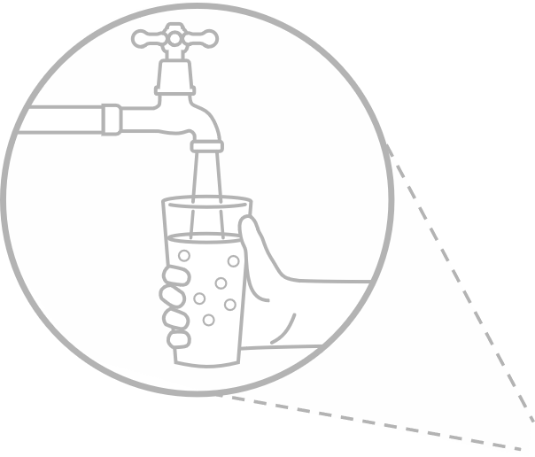


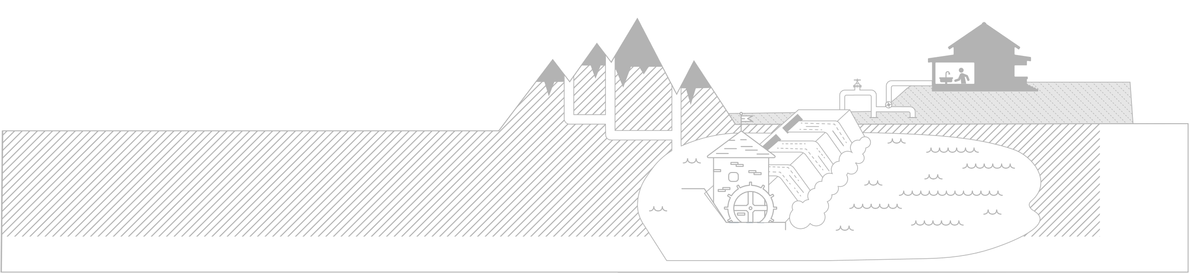


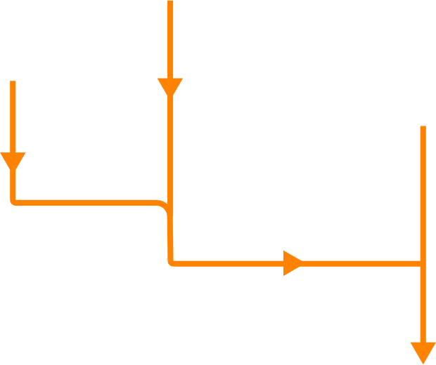


Key aspects of our data lake solution
The HPCC Systems advantage
1. Multiple types of raw data
Open source data lake platform
Batch, real-time and streaming data ingestion
Built-in data enhancement and Machine Learning APIs
Scalable to many petabytes of data
Runs on commodity hardware and in the cloud
Increased responsiveness to customers and stakeholders
5. Information Delivery
2. Batch, real-time and streaming ingestion
4. Data wrangling and machine learning
3. Open source data lake

Slide 5
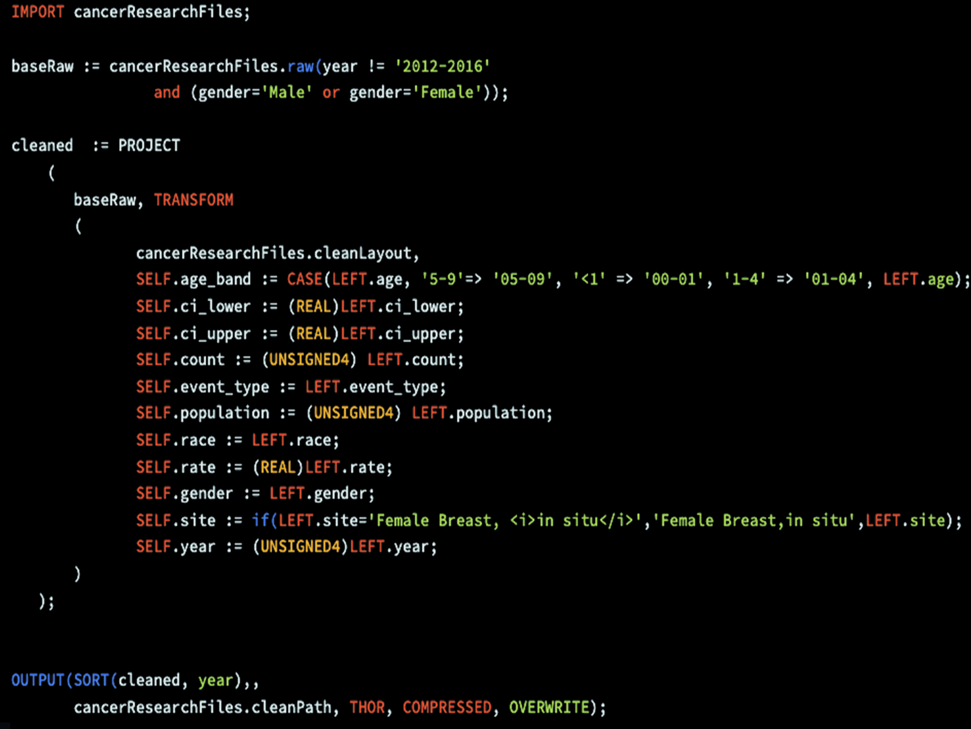
Debug and program data flows with ECL

Slide 6

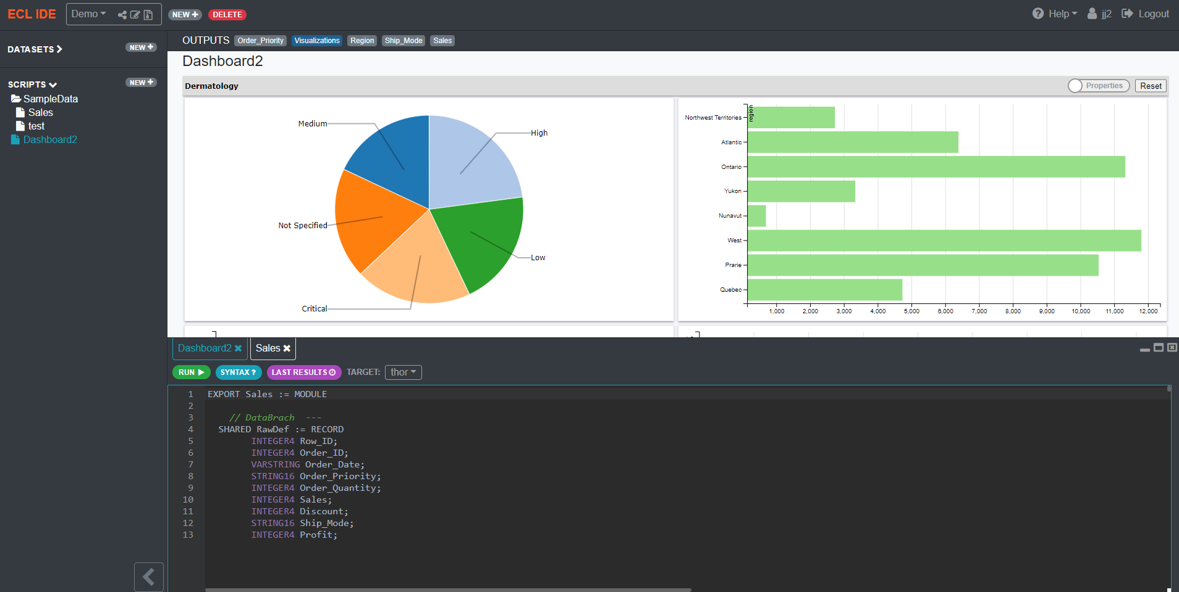
ECL Cloud IDE
Complete coding environment for both advanced data scientists and beginners
Easy learning curve with an intuitive experience
Sharing an integrated application experience with others has never been easier
Notes:
ECL Cloud IDE:
With the advent of cloud based implementations, there is a demand for cloud ready tools that are both powerful and easy to use. ECL Cloud IDE is a complete coding environment for both advanced data scientists and beginning ECL developers. The Cloud IDE is designed to reduce the learning curve to execute data science projects by providing an intuitive online experience. Working with datasets and sharing an integrated application experience with others has never been easier.

Slide 7
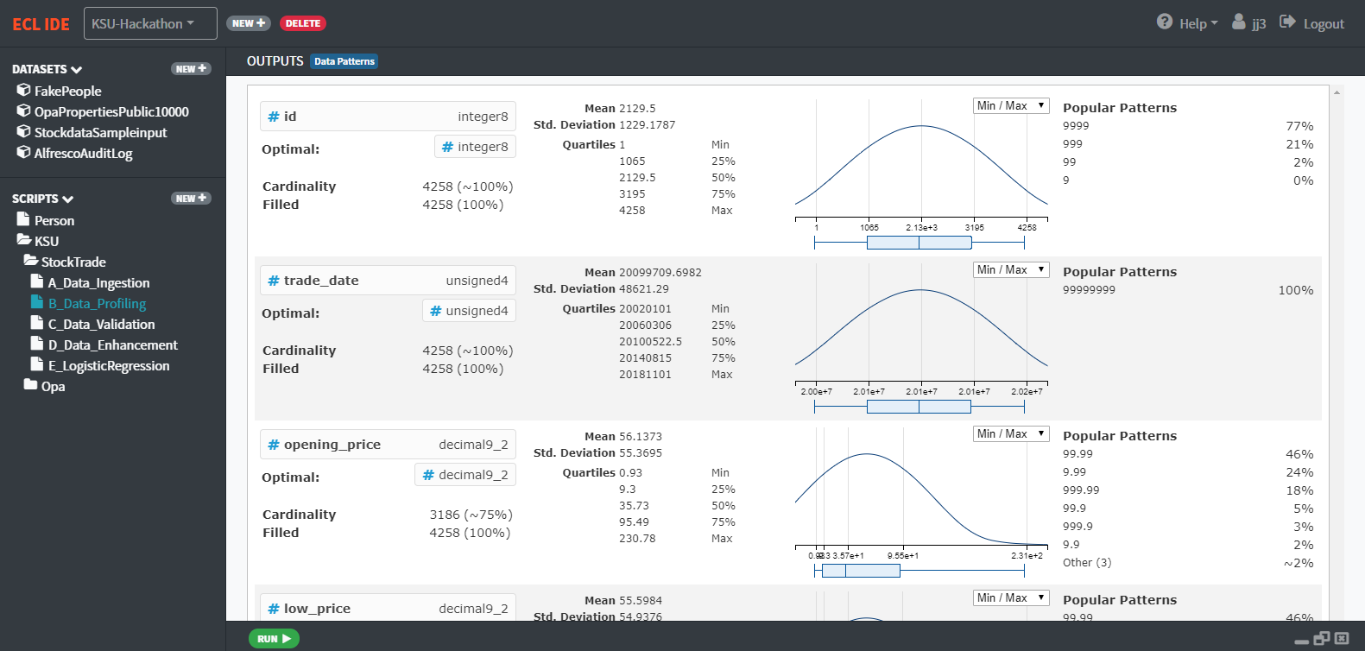
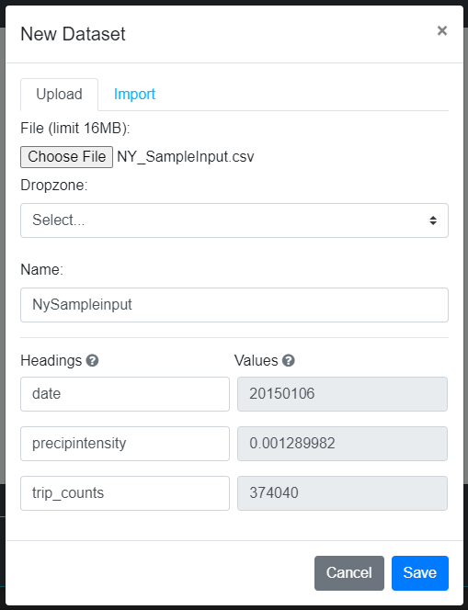
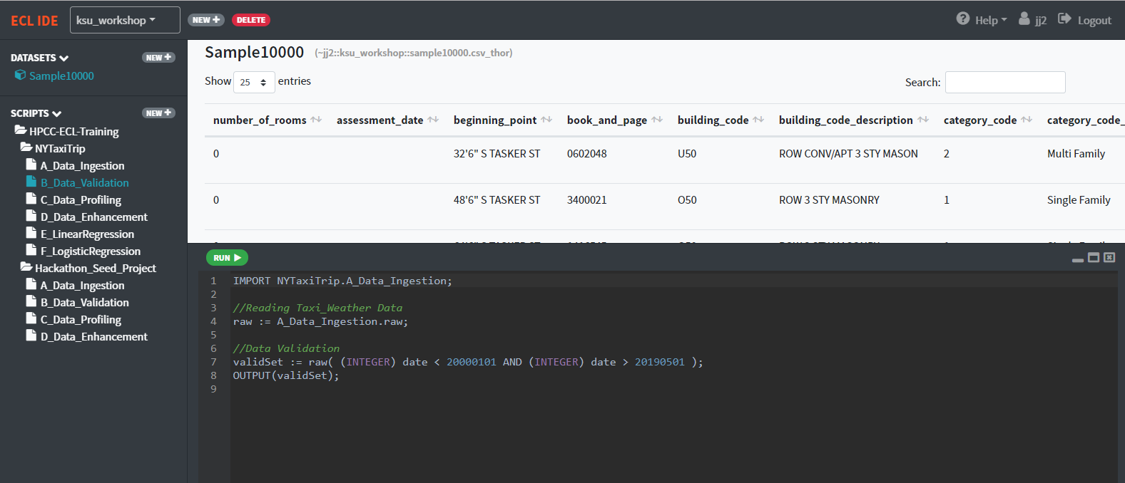
ECL Cloud IDE
Data Patterns
File Upload & Spray
Datasets and ECL scripts

Slide 8
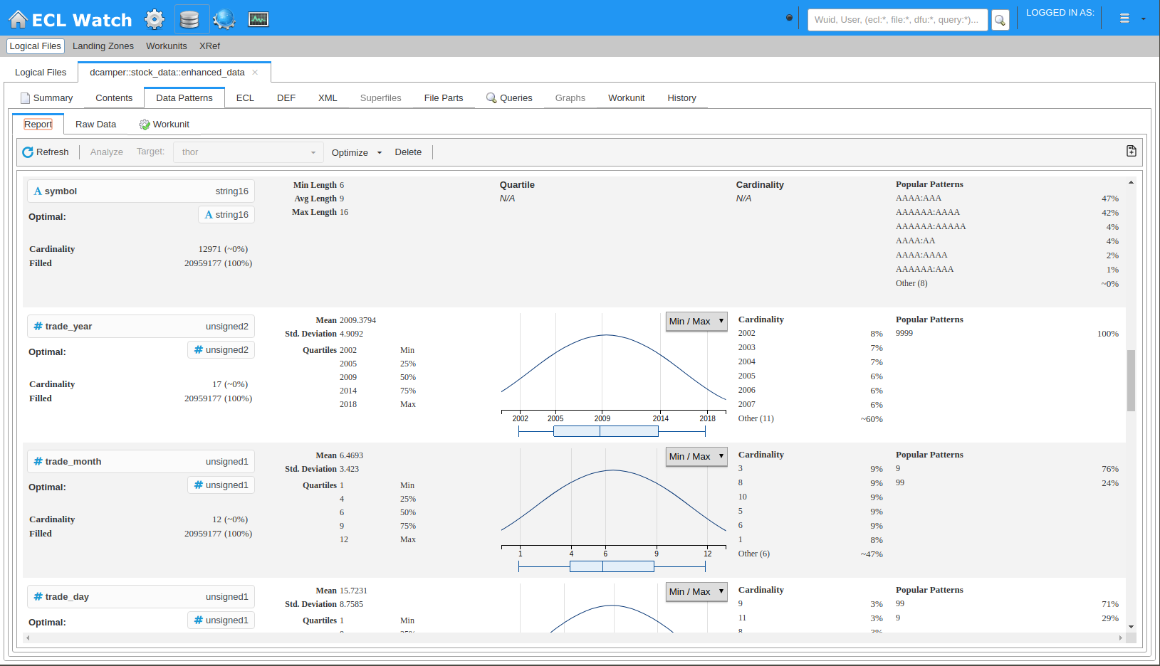
Integrated Data Profiling
Built-in data profiling exposes field-level details
Fill rates and cardinality details
Numeric range detail, including quartiles
Textual patterns highlight common and rate formats

Slide 9
HPCC SYSTEMS

Slide 10
Anatomy of a Big Data Processing System
Big Data
Smaller Data
Compute
Divide

Slide 11
Big Data Life Cycle
Collection: Collecting data in structured, unstructured format
Ingestion: Extracting, transform, loading, data to cluster
Discovery: Getting to know data, cleaning and shaping it
Integration: Linking, indexing, data fusion
Analysis: Machine learning, analytics and statics, visualization
Delivery: Query, summery, result, and availability

Slide 12
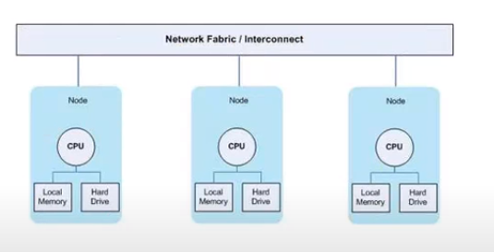
HPCC Systems Infrastructure
Complete data lake management platform
From a personal computer to hundred nodes to cloud
Commodity Cluster: Multiple independent processing nodes.
Commercial off-the-shelf components(COTS)
ECL (Enterprise Control Lang)
Supports different data types: xml, json, csv, flat, etc
Clusters
Thor
Roxie
Servers
Dali
Sasha

Slide 13
HPCC Platform Supports
High performance data delivery through web services, API and SQL
Easy integration with end user BI tools and workflows
Built-in plugins to support other languages such as Python, SQL, C++
Machine Learning library
Deep Learning built on top of TenserFLow
Built-in Data Profiling tool

Slide 14
Thor
Data refinery, data transformation
One job at a time
Parallel processing
Parallel processing using indexing
Horizontally scalable
Can work with mixed schema data
Zero fault tolerant

Slide 15
Thor
Analytics
Profiling
Transform
Thor cluster
Data Refinery
Engine
Manage data more quickly and efficiently
Cleaning

Slide 16
Roxie
Data delivery
Real time query
High throughput data ingestion and processing
Interfaces: SOAP, XML, REST, SQL
Integrates with: Couchbase, MySQL, Kafka, MariaDB
Different type of data storage, fuzzy logic, multi-key retrieval, key-value store and more
Scalable
Zero fault tolerance

Slide 17
ROXIE
Perform real-time queries with highly concurrent delivery
ROXIE cluster
Data Delivery Engine
Interfaces
JSON
XML
REST
SQL

Slide 18
ECL Watch

Slide 19
ECL Watch
Browser-based interface that provides admin control over a cluster
Monitor cluster status
Job information
View Data Profile
Schedule and reschedule periodic tasks
Manage data
Maintain Roxie queries
Security management
Default URL
http://hostname:8010

Slide 20
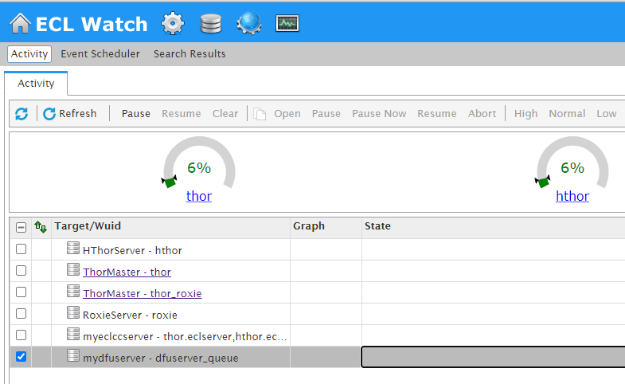
View Workunits
View Files
Published Queries
Cluster Information
Clusters Usage
Clusters Name

Slide 21
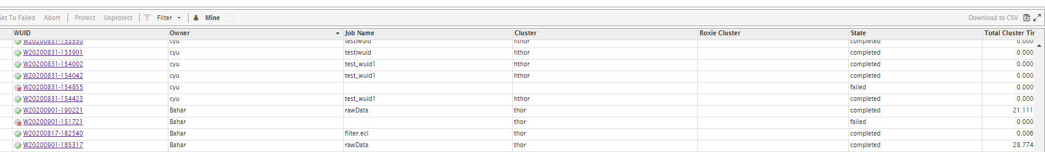
Workunits
Workunits displays:
Workunit ID
Owner
Job Name
Cluster job ran on
Job state (Compile, execute, complete, fail)
Total run time
Each workunit provides details such as:
Job information
ECL code
Outputs
Job workflow
Further action items
Publish the job

Slide 22
Data Profiling

Slide 23
Data profiling
Discovery, Cleaning and Monitoring data:
Data knowledge
Data decision
Data inconsistency
Problem detection

Slide 24
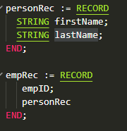
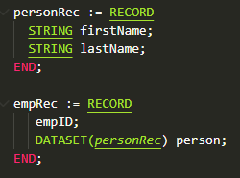
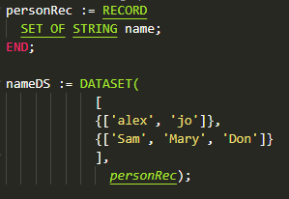
How does it work
Looks at every single value in a dataset
For each field it provides a record
Works with embedded child record
Works with child datasets
Supports SET OF

Slide 25
How to Access
Part of standard library
IMPORT STD.DataPatterns;
ECL bundle
https://github.com/hpcc-systems/DataPatterns
Through ECL Watch

Slide 26
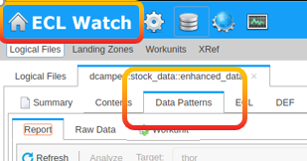
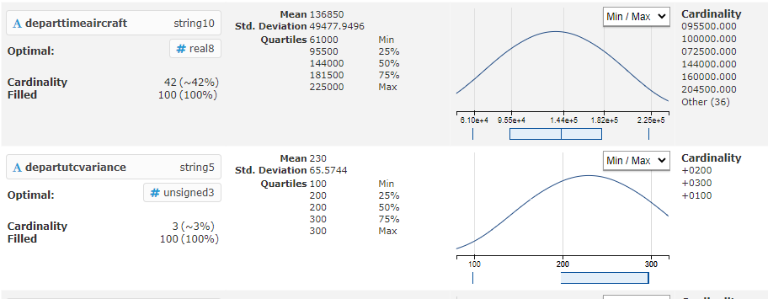
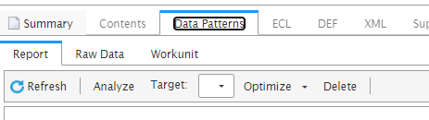
From ECL Watch
Open ECL Watch
Select your file
If the first time
Select your cluster
Hit Analyze

Slide 27
ECL & Big Data

Slide 28
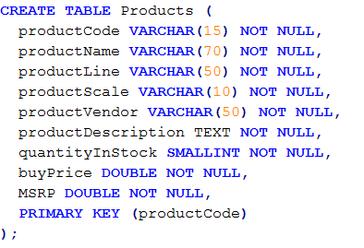
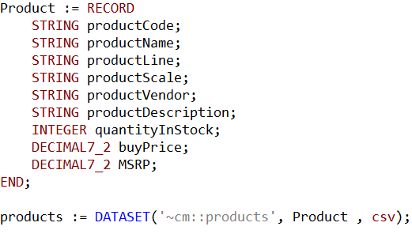
SQL vs. ECL (table and dataset)
SQL
ECL

Slide 29
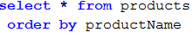
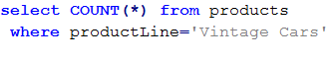
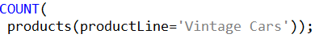
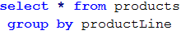
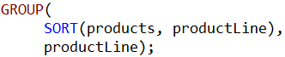
SQL vs. ECL (sort, count, group)

Slide 30
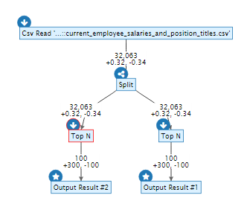
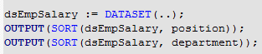
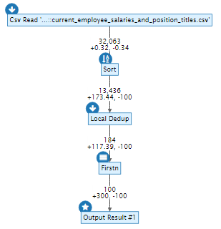
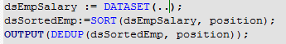
ECL: A Powerful Data Flow Language
How the system executes it
How you code

Slide 31
ECL
Source
ECL is a language design to query/manipulate massive data and is used for ETL (Extract, Transform, Load) and data visualization.
Extract
Reading data from different type of datasets
Transform
Formatting/converting data to needed shape, so it can be used
Load
Writing dataset to it’s target location
Extract
Transfer
Load
Destination

Slide 32
House Keeping
Declarative Lang
Not case-sensitive
White space is ignored
Formatting is recommended
// This is a single line comment
/* A block comment */
Object.Property syntax is used to qualify definition scope and disambiguate field references within datasets:
ModuleName.Definition //reference a definition from another module/folder
Dataset.Field //reference a field in a dataset or record set

Slide 33
House Keeping Cont
Definition assignment is :=
Semicolon terminator: num := 12;
Equality test is = valOne = valTwo
Attributes can be defined only once
Only those definitions that contribute to a result are actually compiled and used
There are no loops. TRANSFORM and PROJECT is used instead.

Slide 34
Common Data Types
Character
STRING[n]
UTF8
UNICODE[_locale][n]
Other
BOOLEAN
SET OF <type>
RECORD
DATASET
Numeric
INTEGER[n]
UNSIGNED[n]
REAL[n]
DECIMAL<n>[_y]
UDECIMAL<n>[_y]

Slide 35
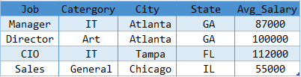
Record Structure
Defines the layout of fields in the dataset, order of the fields should be the same as the dataset.
Dataset
A physical data file. It can be defined in code (inline), or can be read from disk.

Slide 36
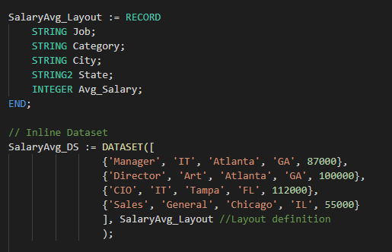
Inline Dataset

Slide 37
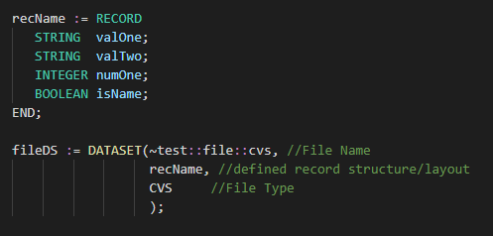
Import Dataset
FLAT Native file type for Thor; also used for fixed-length raw records
CSV Any kind of delimited data, including CSV-encoded data
JSON Data stored as a series of JSON objects
XML Data stored as a series of XML documents
PIPE Data obtained dynamically via process calls

Slide 38
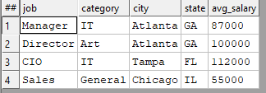
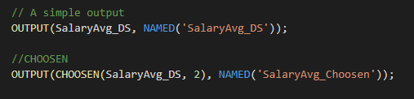
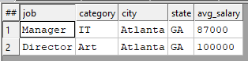
OUTPUT
Lets display result.
CHOOSEN
Returns the first n number of records.

Slide 39
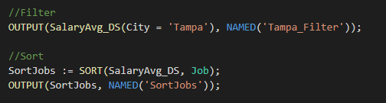
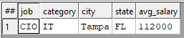
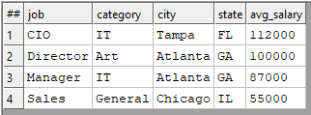
SORT
Ascending or descending sort
FILTER
Choosing a smaller part of dataset

Slide 40
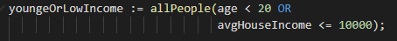
FILTER
All records within dataset will be evaluated
If boolean_expression evaluates to TRUE for a particular record, it will be included in the result
Logical Operators
AND
OR
NOT or ~
Comparison Operators
=
<> or !=
<
>
<=
>=
<=>

Slide 41
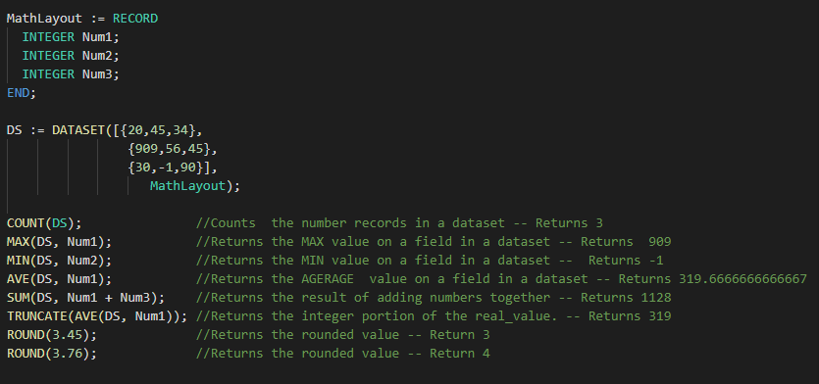
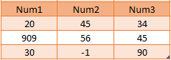
Math Functions

Slide 42
Correlation
When two sets of data are strongly linked together we say they have a High Correlation.
Correlation can have a value:
1 is a perfect positive correlation
0 is no correlation , no relationship between values
-1 is a perfect negative correlation

Slide 43
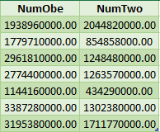
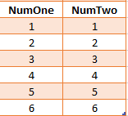


Correlation
Returns 1.0
Returns 0.4978702535543908

Slide 44
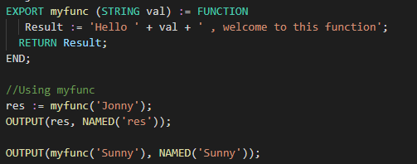
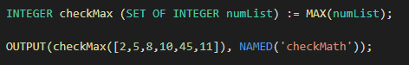
FUNCTION
One Line Function

Slide 45
MODULE
Is a container that allows you to group related definitions. The parameters passed to the module are shared by all the related members definitions.
Variable Scope
Local definitions are visible only up to an EXPORT or SHARED
SHARED definitions are visible within module.
EXPORT definitions are visible within and outside of a module .

Slide 46
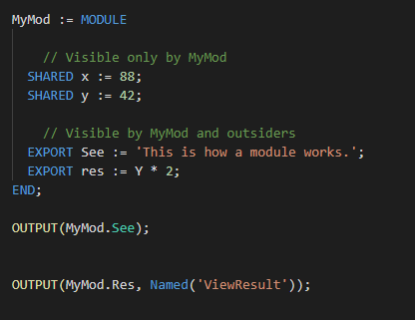
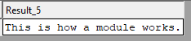
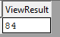

Slide 47
TRANSFORM
Specifies exactly how each field in the output record set is to receive its value.
It should include the result type.
Should contain name
Contains parameter list
SELF: refers to fields in result type.
PROJECT
Processes through all the records in the dataset performing TRANSFORM.
LEFT: refers to dataset getting passed to PROJECT.

Slide 48
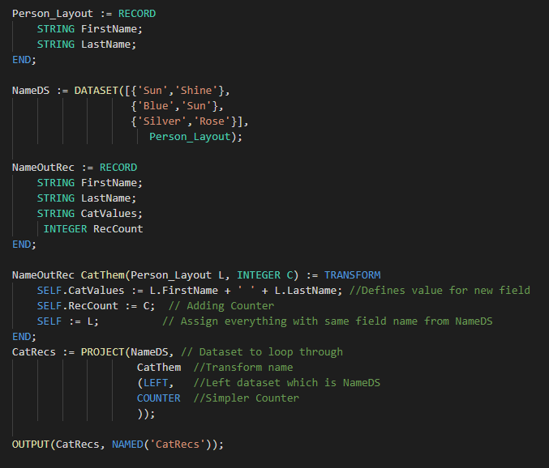
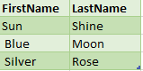

Standalone TRANSFORM
NameOutRec: Result Layout
CatThem: Transform Name
Person_Layout: Input Dataset Layout
L : Reference to Person_Layout fields
SELF: Refers to fields in result dataset
C: Will do the Counting

Slide 49



Inline TRANSFORM
CatRecs: Project Name
NameDS: Input Dataset to loop through
NameOutRec: Result layout
SELF: Refers to fields in result dataset
SELF := LEFT: Assign everything with same field name from NameDS
SELF := []: All un-assigned fields will be set to default values

Slide 50



TABLE
Creates a temporary dataset in memory, GROUP option can be used.

Slide 51
JOIN
The JOIN function produces a result set based on the intersection of two or more datasets or indexes.
INNER: Only those records that exist in both datasets.
LEFT OUTER: At least one record for every record in the left.
RIGHT OUTER: At least one record for every record in the right.
LEFT ONLY: One record for each left record with no match in the left.
RIGHT ONLY: One record for each left record with no match in the right.
FULL ONLY: One record for each left and right record with no match in the opposite.

Slide 52








EmpDS
JobCatDS

Slide 53
ECL VISULIZER

Slide 54
VISUALIZATION
Methods include
Two-Dimensional
Multi-Dimensional Methods
Geospatial
General
A basic visualization typically requires the following steps:
1. Creation of a suitable dataset.
2. Output the dataset with a suitable name, so that visualization can locate the data.
3. Create (and output) the visualization, referencing the named output from step

Slide 55
ECL - Data Visualization
IMPORT Visualizer;
Creation of a suitable dataset. Make sure your data is aggregated and meaningful.
Output the dataset with a suitable name, so that visualization can locate the data.
Create (and output) a visualization, referencing the named output from step 2.

Slide 56


ECL - View Visualization
In WatchPage, under Resources tab

Slide 57

ECL - Dermatology
The Dermatology Editor lets you alter the appearance of the visualization after it has been executed.
The same properties can also be specified in the ECL when creating the visualization.

Slide 58
Visualization Methods/MODULES
Geospatial Mod
US States
US Counties
Euro
EuroIE
EuroGB
Two Dimensional Mod
Bubble
Pie
Summary
WorldCloud
Multi Dimensional Mod
Area
Bar
Column
Line
Scatter
Step
General Mod
Grid

Slide 59

Visualizer Options
id Required. Unique identifier for the visualization
dataSource Location of the result set (WUID, Logical File, Roxie query), defaults is current WUID
outputName Required. Result set name (ignored for Logical Files)
filteredBy Filter condition
mappings Maps human labels <--> field IDs
properties Dermatology properties. See Dermatology Properties
ModuleName.Method: Module that graph/chart is located and Method is the name chart/graph.

Slide 60



Slide 61


Choropleth - USStates
The USStates visualization method depicts data on a map of U.S. States.
Takes two values
Column1 (string): State 2 letter code
Column2 (number): Value

Slide 62


Choropleth - USCounties
US States Choropleth:
Takes two values
Column1 (number): FIPS Code
Column2 (number): Value

Slide 63
REFRENCES
Learn ECL Academy
https://hpccsystems-solutions-lab.github.io
ECL training containing six short videos
https://www.youtube.com/watch?time_continue=192&v=Lk78BCCtM-0
ECL document
http://cdn.hpccsystems.com/releases/CE-Candidate-7.0.24/docs/EN_US/ECLLanguageReference_EN_US-7.0.24-1.pdf
Visualization document
https://d2wulyp08c6njk.cloudfront.net/releases/CE-Candidate-7.6.2/docs/EN_US/VisualizingECL_EN_US-7.6.2-1.pdf
Visualizer Library
https://github.com/hpcc-systems/Visualizer
Standard Library
https://cdn.hpccsystems.com/releases/CE-Candidate-7.10.16/docs/EN_US/ECLStandardLibraryReference_EN_US-7.10.16-1.pdf

Slide 64


